Slide 1
Why Python?
Open Source – free to install (compare to Matlab)
Great online community
Easy to learn
Can be used for both data science as well as the complete software stack.
Needless to say, it still has a few drawbacks too:
It is an interpreted language rather than compiled language – hence might take up more CPU time.
It is getting faster

Slide 2
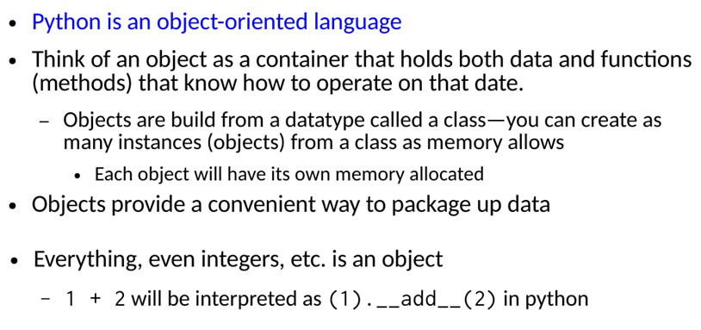
Object Oriented

Slide 3
Installation, environment, etc.

Slide 4
Python 2.7, 3.5, 3.6, 3.7
The choice of python version depends on your application
3.* mostly backward compatible
2.7: some libraries still work with 2.7
3.4/3.5/3.6/3.7: cleaner, faster, the future
3.9 released in June 2020

Slide 5
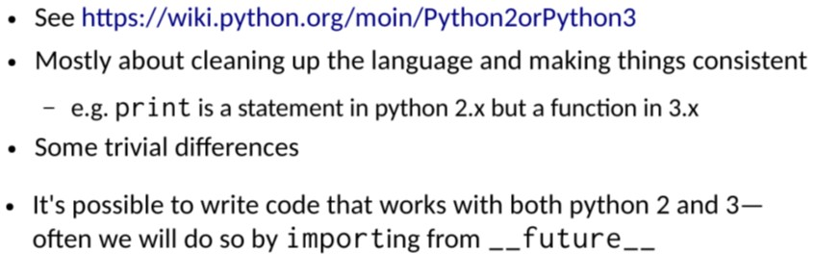
Python 2 vs. 3

Slide 6
Your Computer: Installing Anaconda
Two Options:
Standalone Python Link (https://www.python.org/downloads/)
Scientific Bundles such as Anaconda
https://docs.anaconda.com/anaconda/install/windows/
Anaconda in recommended since it contains
most of the relevant libraries

Slide 7
Execution -- Python Shell
Python shell:
Standard interactive way of using python
Runs in terminal (command prompt) window
Has basic interactive interface
Type
python or python3 at command prompt
idle or idle3 to open script window

Slide 8
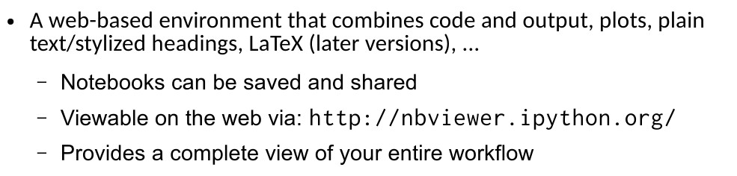
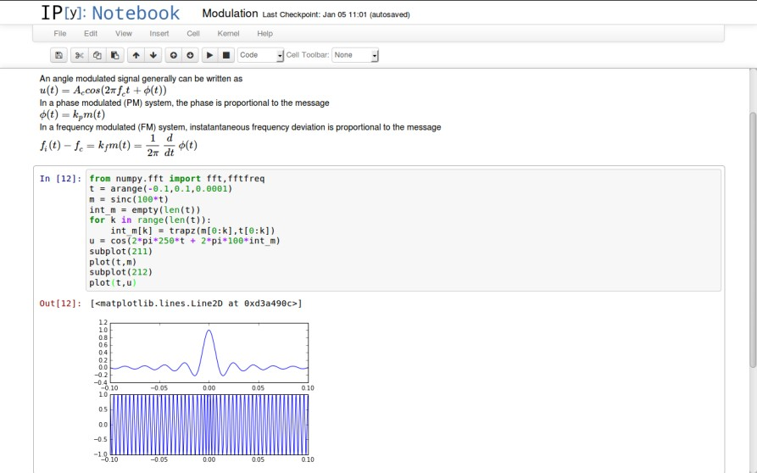
Jupyter Notebook

Slide 9
Some Notes on Notebook
You can start Jupyter notebook by writing “jupyter notebook” on your terminal / cmd, depending on the OS you are working on
The interface shows In [*] for inputs and Out[*] for
output.
You can execute a code by pressing “Shift + Enter” or “ALT + Enter”, if you want to insert an additional row after.

Slide 10
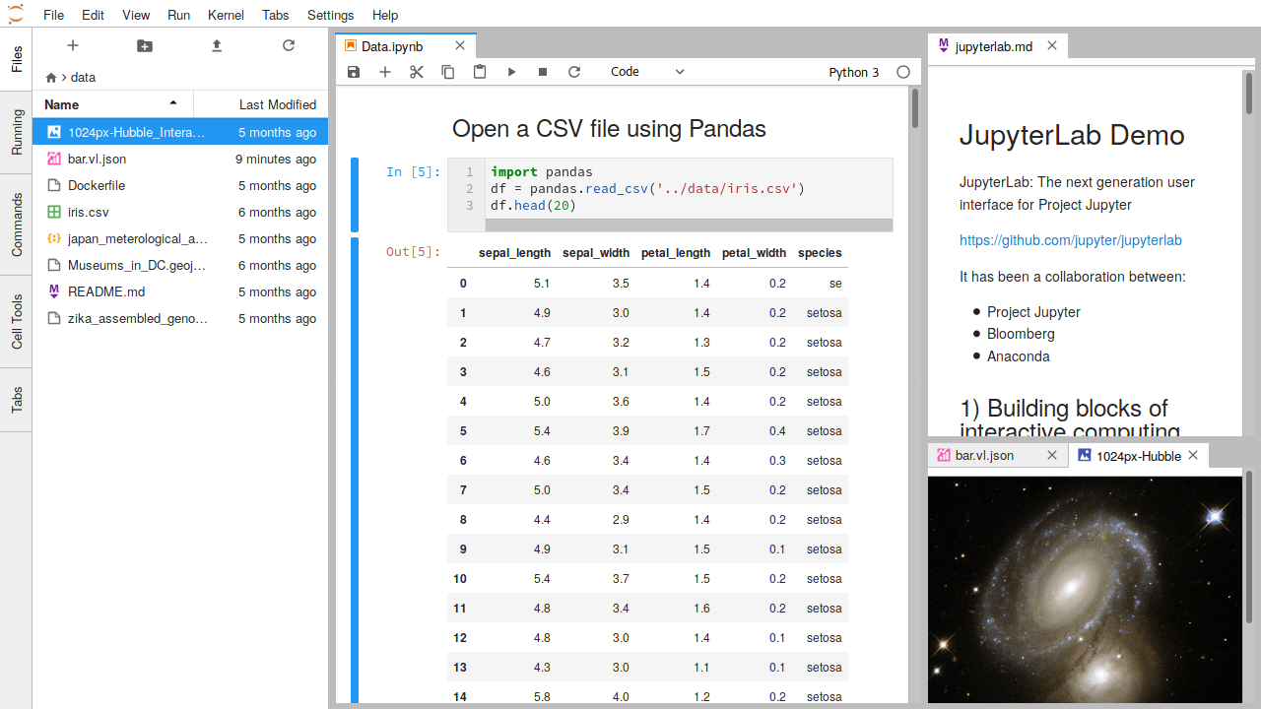
Jupyter Lab
The next-generation user interface for Project Jupyter
A more flexible and powerful user interface
Stable version was released in February 2018

Slide 11
Using Python
Different ways to use Python
Terminal / Shell based
IDLE, installed with standalone Python
Jupyter notebook
Tutorial - https://www.youtube.com/watch?v=HW29067qVWk
Jupyter Lab (to replace Jupyter Notebook)
Spyder

Slide 12
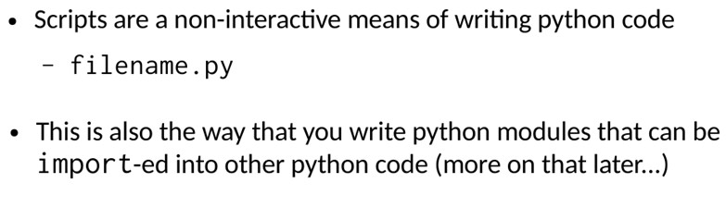
Python Scripts

Slide 13
Data Structures

Slide 14
Data Structures
Lists
Strings
Tuples
Dictionary

Slide 15
Lists
Lists are one of the most versatile data structure in Python.
A list can simply be defined by writing a list of comma separated values in square brackets.
Lists might contain items of different types, but
usually the items all have the same type.
Python lists are mutable and individual elements of a
list can be changed.

Slide 16
Lists
Items can be grouped into a list
myList = [1,2,3,4,5]
Access each value in the list – by index
Slice: access a subset of the list
myList[f:t] -- myList[f], myList[f+1], …, myList[t-1]
‘f’ can be omitted if first; ‘t’ can be omitted if last
Forward index | 0 | 1 | 2 | 3 | 4
 | 1 | 2 | 3 | 4 | 5
backward | -5 | -4 | -3 | -2 | -1

Slide 17
Slices
myList[f:t] # items from f through t-1
myList[f:] # from f through the rest
myList[:t] # from beginning through t-1
myList[:] # whole items
myList[-2:] # last two items
myList[:-2] # whole items except the last two
Slices have 3rd value
myList[f:t:step] # skip items by step
Default value of step is 1
myList[::-1]

Slide 18
Examples
In the Python3 IDLE (Shell), enter following statements and write what python prints below statements
>>> myList = [0,1,2,3,4,5,6]
>>> myList[0]
>>> myList[2]
>>> myList[:2]
>>> myList[2:]
>>> myList[-3:-1]
>>> myList[-3:]
>>> myList[-3:0]
>>> myList[:-3]

Slide 19
Operating with Lists
Change an element in a list (replace)
Add an element
myList.append()
myList.insert(0, -1)
Remove an element
del myList[1]
myList.remove(3)

Slide 20
Sort
myList.sort()
myList.sort(reverse=True)
myList.sorted() # does not update original myList
Reverse
myList.reverse()
# of elements in a list
len(myList)

Slide 21
Strings
Strings can simply be defined by use of single ( ‘ ), double ( ” ) or triple ( ”’ ) commas
Strings enclosed in tripe quotes ( ”’ ) can span over multiple lines and are used frequently in docstrings (Python’s way of documenting functions)
\ is used as an escape character.

Slide 22
String and list
work the same way
Slices
myStr[start:end] # items from start through end-1
myStr[start:] # from start through the rest
myStr[:end] # from beginning through end-1
myStr[:] # whole items
myStr[-2:] # last two items
myStr[:-2]
Python strings are immutable
No operations to change strings
x.append()
x.insert(0, -1)
del x[1]
x.remove(3)

Slide 23
zip operator in lists
L1,L2,L3,… are lists
zip(L1,L2,L3,..) # combines elements into a tuple
>>> chars = ['a','b','c']
>>> val = [0,1,2]
>>> x,y,z = zip(chars, val)
>>> x
('a', 0)
>>> pairs = list(zip(chars, val))
>>> pairs
[('a', 0), ('b', 1), ('c', 2)]
* unpacks arguments
>>> x,y= zip(*pairs)
>>> x
('a', 'b', 'c')
>>> unpack = list(zip(*pairs))
>>> unpack
[('a', 'b', 'c'), (0, 1, 2)]

Slide 24
Tuples
A tuple is represented by a number of values separated by commas.
myTuple1 = 3, 4
myTuple2 = (3,4)
x,y=3,4
Tuples are immutable and the output is surrounded by parentheses so that nested tuples are processed correctly.

Slide 25
Dictionary
Dictionary is an unordered set of key: value pairs, with the requirement that the keys are unique (within one dictionary).
A pair of braces creates an empty dictionary: {}.
Grades = {“a”:80, ”b”:70}

Slide 26
Prog. Control

Slide 27
Conditional Statement
The most commonly used construct is if-else, with following syntax:
if [condition]:
execution if true
else:
execution if false

Slide 28
Python Structures
Colon(:) -- Indicates the end of a Python structure
if ( ):
for t in range(0,n):
while ( ):
def :
Indentation – nesting depth
no {}

Slide 29
Loops
For loops have a simple structure
for i in [Python Iterable]: expression(i)
Here “Python Iterable” can be a list, tuple or other
advanced data structures

Slide 30
“for” loop
for p in range(min, max, interval):
block
p=min
true
p = max-1
false
Do block
p = p + interval
Out of “for”

Slide 31
e.g. – Linear Search
n values in aList[0], aList[1], . . . aList[n-1]
Compare aList[0]
Match the key, return with index 0
else continue comparing with the rest
Key is not in the list, return -1
Exhaust the search
for k in range(0, n):
if key == aList[k]:
return k
What if key is not in the list ?

Slide 32
Linear Search
def linearSearch(list):
max = len(list)
for k in range(0,max):
if key == list[k]:
return k
return -1

Slide 33
Linear Search
Code can be made more explicit
Interested in the key being found or not
Use a boolean variable ‘found’
def linearSearch(key, list):
max = len(list)
found = False
k = 0
while k<n and not found:
if key == list[k]:
found = True
else:
k = k+1
if found:
return k
else:
return -1

Slide 34
Libraries
The first step is obviously to learn to import them into our environment. There are several ways of doing so in Python:
import math as m
from math import *

Slide 35
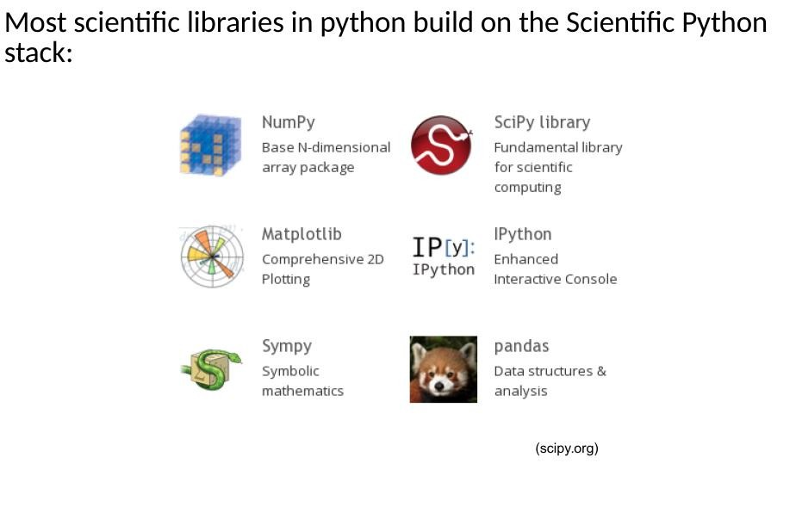
Scientific Python Stack

Slide 36
Some Libraries
NumPy stands for Numerical Python. The most powerful feature of NumPy is n-dimensional array. This library also contains basic linear algebra functions, Fourier transforms, advanced random number capabilities and tools for integration with other low level languages like Fortran, C and C++
SciPy stands for Scientific Python. SciPy is built on NumPy. It is one of the most useful library for variety of high level science and engineering modules like discrete Fourier transform, Linear Algebra, Optimization and Sparse matrices.
Matplotlib for plotting vast variety of graphs, starting from histograms to line plots to heat plots.. You can use Pylab feature in ipython notebook (ipython notebook –pylab = inline) to use these plotting features inline. If you ignore the inline option, then pylab converts ipython environment to an environment, very similar to Matlab.

Slide 37
Some Libraries
Pandas for structured data operations and manipulations. It is extensively used for data munging and preparation. Pandas were added relatively recently to Python and have been instrumental
in boosting Python’s usage in data scientist community.
Scikit Learn for machine learning. Built on NumPy, SciPy and matplotlib, this library contains a lot of efficient tools for machine learning and statistical modeling including classification, regression, clustering and dimensionality reduction.
Statsmodels for statistical modeling. Statsmodels is a Python module that allows users to explore data, estimate statistical models, and perform statistical tests. An extensive list of descriptive statistics, statistical tests, plotting functions, and result statistics are available for different types of data and each estimator.

Slide 38
Some Libraries
Seaborn for statistical data visualization. Seaborn is a library for making attractive and informative statistical graphics in Python. It is based on matplotlib. Seaborn aims to make visualization a central part of exploring and understanding data.
Bokeh for creating interactive plots, dashboards and data applications on modern web-browsers. It empowers the user to generate elegant and concise graphics in the style of D3.js. Moreover, it has the capability of high-performance interactivity over very large or streaming datasets.
Blaze for extending the capability of Numpy and Pandas to distributed and streaming datasets. It can be used to access data from a multitude of sources including Bcolz, MongoDB, SQLAlchemy, Apache Spark, PyTables, etc. Together with Bokeh, Blaze can act as a very powerful tool for creating effective visualizations and dashboards on huge chunks of data.

Slide 39
Some Libraries
os for Operating system and file operations
networkx and igraph for graph based data manipulations
regular expressions for finding patterns in text data
BeautifulSoup for scrapping web. It is inferior to Scrapy as it will extract information from just a single webpage in a run.

Slide 40
Numpy
ndarray (n-dimensional array)
ndarray - Multidimensional container
shape – defines # of dimensions and sizes in each dimension
dtype - data type

Slide 41
Numpy
ndarray (n-dimensional array)
>>> import numpy as np
>>> x = np.array([[1,2,3],[4,5,6]])
>>> type(x)
<class 'numpy.ndarray'>
>>> x.shape
(2, 3)
>>> x.dtype
dtype('int64')
>>> x
array([[1, 2, 3],
[4, 5, 6]])
>>> x.T
array([[1, 4],
[2, 5],
[3, 6]])
>>> x.flat[1]
2
>>> x.shape=(3,2)
>>> x
array([[1, 2],
[3, 4],
[5, 6]])

Slide 42
Numpy
https://docs.scipy.org/doc/numpy/reference/generated/numpy.linalg.eig.html
Linear algebra

Slide 43
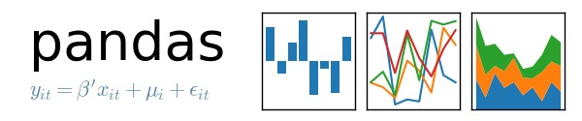
Why Pandas?
NumPy is low-level library
It allows us to deal with data in a user-friendly; using labelled columns and indexes
It allows us to easily import data from files such as
.csv files
It allows us to perform complex functions on data
….

Slide 44
Pandas Data Structures
Series
DataFrame

Slide 45
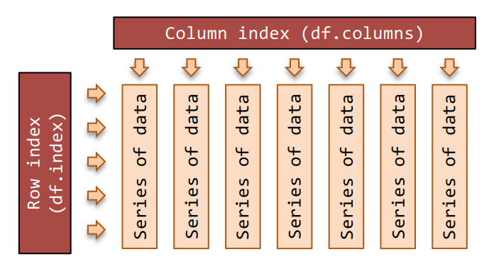
DataFrame
The pandas DataFrame is a two-dimensional table of data with column and row indices.
The columns are made up of pandas Series objects.

Slide 46
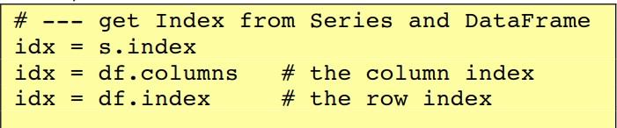
Index
The pandas Index provides the axis labels for the Series and DataFrame objects.
A pandas Series has one Index; and a DataFrame has two Indices.

Slide 47
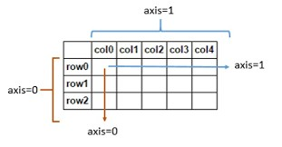
DataFrame
Axis 0 and axis 1 are similar to NumPy’s axes

Slide 48
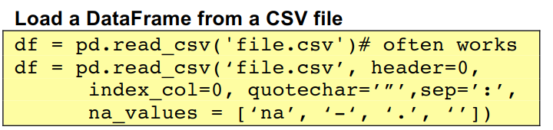

Reading and Writing Data

Slide 49
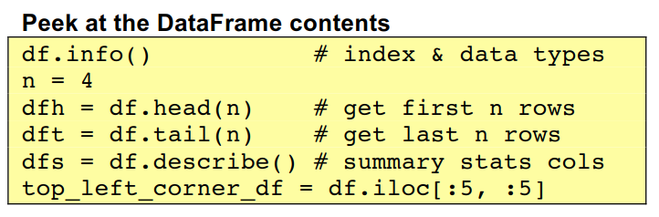
Working with Data

Slide 50
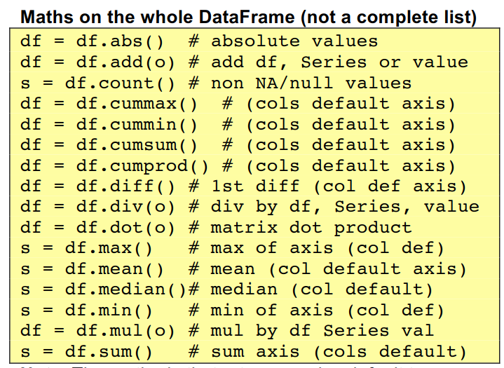
Working with Data

Slide 51
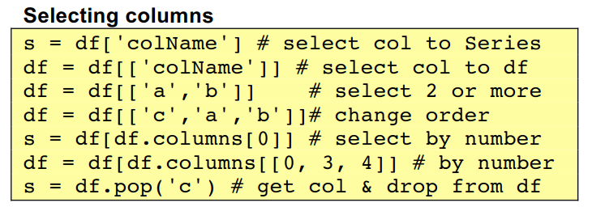
Selecting Columns

Slide 52
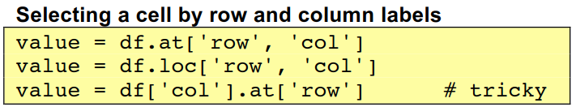
Selecting a Cell
We can select specific ranges of data in both the row and column directions using either label or integer-based indexing. We can use one of these methods:
loc: indexing via labels
iloc: indexing via integers
at: returns a scalar

